Slide 1

PATIENT-SOVEREIGN
MEDICAL TRUST NETWORK
A patient-controlled healthcare trust network with cryptographic consent, AI-assisted prescription safety, and continuous fraud detection
Patient-Controlled Access
Cryptographic Consent
AI Prescription Safety
Fraud Detection
Hackathon Solution Overview

Slide 2
The Problem
Healthcare data today is fragmented and patients rarely control who sees it
1
Hospitals, pharmacies, and insurers hold separate, siloed records with no unified patient control
Our Answer
2
Access is granted broadly, not scoped — a doctor sees far more than the current visit requires
The patient becomes the final authority over every access to their medical record — every request is scoped, every approval is cryptographically signed, and every event is auditable.
3
Prescriptions and claims can be altered or duplicated without anyone noticing until it's too late
4
Patients have no clear, trustworthy record of who accessed their data, when, and why

Slide 3


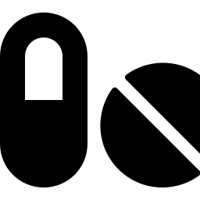
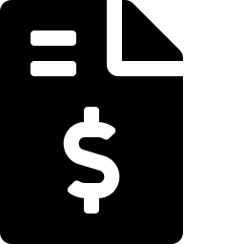

System Architecture
Patient at the center, trust layer in the middle, three role-based dashboards, AI intelligence underneath
PATIENT
TRUST & CONSENT LAYER
Identity
Access Ctrl
Signatures
Audit Ledger
Fraud Detect
Doctor / Hospital
Pharmacy
Insurance
AI CLINICAL INTELLIGENCE — Safety Analysis + Fraud/Anomaly Analysis

Slide 4
Three Role-Based Dashboards
Every user sees only the tools and data relevant to their role
Patient Dashboard
Doctor / Hospital
Pharmacy / Insurance
Health summary, prescriptions & allergies
Search patients, request only needed fields
Verify signature, expiry & redemption status
Approve, reject, revoke access requests
View records only after valid consent
Record dispensing transactions
Signed prescriptions + AI explanations
Create prescriptions + run AI safety checks
Cross-check claims vs. prescriptions
Full audit timeline & security alerts
Digitally sign every prescription
Monitor fraud & anomaly alerts

Slide 5

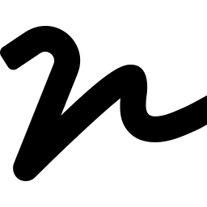



End-to-End Workflow
From registration to a fully audited, signed clinical transaction
1
2
3
4
Registration
Access Request
Consent & Sign
Scoped Access
Patient account creates a unique ID + cryptographic identity
Doctor requests only the minimum fields, states purpose & duration
Patient approves via QR + phone biometric; signed consent is created
Doctor sees only the authorized fields — nothing more
5
6
7
8
AI Safety Check
Doctor Signs
Pharmacy Verify
Claim & Audit
Prescription is screened for allergy, interaction & dosage risk
Finalized prescription gets a signature + integrity hash
Signature, expiry & redemption checked before dispensing
Insurance cross-checks the claim; every event lands on the timeline

Slide 6



Crypto Trust Engine
The security core — standalone, pluggable, and independently demonstrable
CRYPTO TRUST ENGINE
Identity Service
Consent Service
Signature Service
Patient key management (ECDSA-P256)
Scoped consent + expiry
Sign / verify any transaction
INTEGRITY SERVICE — Hash + Tamper Check
AUDIT EVENTS

Slide 7
Fraud & Anomaly Detection
Deterministic security rules combined with behavioral anomaly detection
Layer 1 — Deterministic Rules
Layer 2 — Behavioral Anomaly
Invalid signature
Duplicate / rapid prescriptions
Missing / expired consent
Device, location & time anomalies
Prescription already redeemed
Unusual access or claim frequency
Scope or quantity mismatch
Isolation Forest — unsupervised, no labeled fraud data needed
FRAUD RISK SCORE
LOW / MEDIUM → Allow
HIGH → Alert + Review
Every output is phrased as "suspicious activity" or "requires review" — never a confirmed accusation.

Slide 8

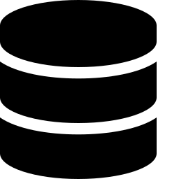
Security & Cryptographic Model
Every access, signature, and record follows the same set of hard rules
No raw biometrics on server
One-time QR, 60s expiry
Off-chain storage + hashes
Fingerprints/face data never leave the device — only a cryptographic proof is sent
QR carries only a short-lived reference/nonce — never medical data
Medical data stays off-ledger; hashes, signatures & an audit layer prove integrity
Every action is scoped
WebAuthn / passkeys
Every action is audited
Requester, fields, purpose and expiry are bound into every access grant
Phone/device biometric authentication through a secure standard mechanism
Security-sensitive events create an audit event, visible to the patient

Slide 9

Proposed Tech Stack
Three independent modules, one shared JSON contract
Frontend
Crypto Trust Engine
AI Clinical Intelligence
React (JS / TypeScript)
Node.js + TypeScript
Python
Patient / Doctor / Pharmacy dashboards
node:crypto — ECDSA-P256, AES-256-GCM, SHA-256
Rule-based safety checks + Isolation Forest
Consumes Crypto Engine APIs directly
WebAuthn / passkeys for phone auth
Synthea synthetic patient dataset

Slide 10
Team & Current Progress
Built independently, integrated through a shared JSON contract
Pooja
Aadhesh
Kanish
Frontend
AI Clinical Intelligence
Crypto Trust Engine
Three role-based dashboards (React)
Prescription safety + fraud/anomaly scoring
Identity, consent, signatures, tamper detection
Crypto Trust Engine — Tier 1 core capabilities built and independently tested
Identity generation, AES-GCM encryption, SHA-256 hashing, consent + prescription signing, scope/expiry verification, and tamper detection are all passing their test scenarios — ready to plug into the frontend and AI modules.

Slide 11
5-Minute Demo Flow
What judges will see, start to finish
1
Patient dashboard shows records, allergies & pending requests
6
Doctor reviews, signs the finalized prescription
2
Doctor requests only Medications + Allergies + Prescriptions, with purpose & expiry
7
Pharmacy scans it — Signature Verified / Not Expired / Not Redeemed
3
Patient approves via QR-to-phone biometric / PIN flow
8
Insurance claim is cross-checked against the signed prescription
4
Doctor sees only authorized data and drafts a prescription
9
A controlled fraud scenario is triggered live — tampering is caught
5
AI instantly scores safety and explains allergy / interaction / dosage risk
10
Patient audit timeline shows every event, including the blocked attempt

Slide 12
The patient doesn't just own their
medical data.
They can prove who accessed it, why they accessed it, what they accessed, and whether anything suspicious happened.
Patient-Sovereign Medical Trust Network

